Slide 1





Present
Ideas
Presented by
Mojtaba Mansouri Nejad

Slide 2







Slide 4


Slide 8

Isabel Mercado

Slide 9
CSI
Channel State Information

Slide 10


Channel State Information (CSI) is a set of parameters that describe the conditions of a communication channel between a transmitter and receiver. CSI includes details like the amplitude and phase of signals across different frequency subcarriers. It is used to optimize data transmission and reception in wireless systems like Wi-Fi, 5G, and MIMO by providing insights into channel quality, interference levels, and data rate potential. In research areas such as Wi-Fi-based localization and human activity recognition, CSI is valuable for detecting environmental changes and movements, offering precise data for analysis and prediction.
CSI

Slide 11



Side by Side
Message
Channel

Slide 12
Side by Side
RL
ML

Slide 13
Side by Side
Prediction
Comparison

Slide 14
Ris, Hap, Uav: 3k-5k
ML , RL: 10k
ML,RIS: 0.5k-1k
CSI,RIS,ML: ?

Slide 15
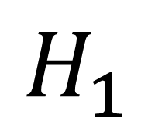
Channel, ML, Comparison
$$H_{1}$$

Slide 16


Channel, ML, Comparison
Train
$$\hat{H_{1}}$$
GAN
$$H_{1}$$
$$H_{1}={\hat{H}}_{1}$$

Slide 17
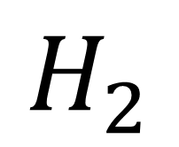
Channel, ML, Comparison
$$H_{2}$$

Slide 18


Channel, ML, Comparison Test
$${\hat{H}}_{2}$$
GAN
$$H_{2}$$
$${\hat{H}}_{2}≠H_{2}$$

Slide 21


Thank You!

